Slide 1

Department of Computer Science and Engineering
Extractive News Summarizer using BERT
Supervisor:
Dr. Yogesh Kumar Meena
Associate Professor
Department of Computer Science and Engineering
Submitted By:
Preet Yadav
Sumit Kumar
Tarishi Jain

Slide 2
Objectives
Extract meaningful interpretation from multiple news articles/text documents of same domain.
Add quality to the summary by applying various models.
Exploring BERT in text summarisation field
Compare our summary with the existing models on evaluation metric like ROUGE and improve the quality of summary.

Slide 3
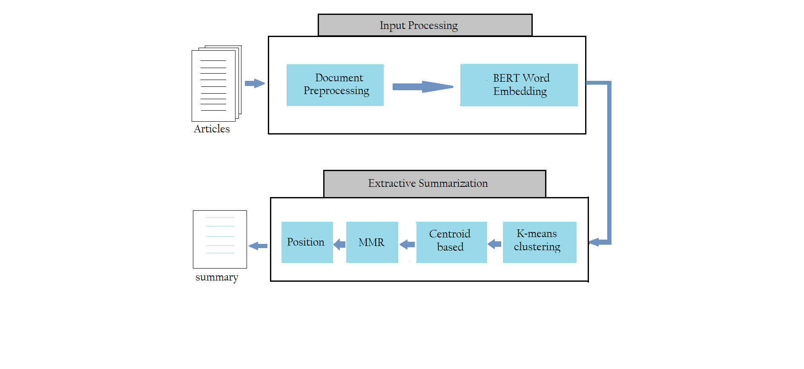
Proposed Architecture..change it or not?

Slide 4
Proposed Architecture:
Input processing
This module processes the input documents by leveraging a pipeline which tokenized the incoming paragraph text into clean sentences.
The sentences are then given to pre-trained Bert model, BERT will convert each input sentence into a vector of fixed size.

Slide 5
Proposed Architecture:
BERT model
BERT is a trained model for NLP tasks, developed by Google in 2018.
BERT can also be used for next sentence prediction.
We will use BERT to extract features from the text data in the form of sentence embedding vectors
BERT offers advantage over other available models like Word2Vec[1]

Slide 6
> The BERT model is modified to generate ` sentence embeddings for multiple sentences.
>The output is then a sentence vector for each sentence.
>we apply word embedding in representing input documents and use it as the input of the k-means algorithm as kmeans do not concern the semantic meaning of text

Slide 7
Proposed Architecture: Extractive summarization
K-means clustering algorithm
K-means clustering algorithm takes as input embedding vectors of sentences created by BERT.
The sentences are then grouped into clusters .
Sentences that are closest to the center of each cluster will be put in the summary as output of this stage.
Thus from each cluster, one sentence will be taken that will represent the whole cluster.
Since each cluster represents a different topic of the input documents, sentences extracted by this way rarely have information overlap

Slide 8
Proposed Architecture: Extractive summarization
Centroid based BERT embedding method
In ordinary centroid-based method, tf.idf score is calculated of the vocabulary words and those which exceed a given threshold value, are taken as centroid words. The sentences which are comprising of most of the centroid words will be taken as part of summary
This ordinary method, when combined with word embeddings can prove to be very effective as proved by (Gaetano Rossiello,2017) in there recent paper[2]

Slide 9
Contd…
In the modified centroid based method, upon calculating the centroid words as was in original method, the BERT word embeddings of the centroid words are stored in a table and centroid vector is calculated as the mean of embeddings of centroid words.
The sentence vector is then calculated as the mean of centroid word embeddings which it contain
The cosine similarity measure is then applied between centroid vector and sentence vector to predict the score of that sentence
Finally, the top score sentences are extracted for summary

Slide 10
Proposed Architecture: MMR and sentence position
MMR is used to remove redundancy sentences from the output of the centroid-based module.
For ordering of sentences, it is kept in mind that adjacent sentences of the summary should possess a good level of similarity to increase the coherence of the summary.
The summary is than evaluated using ROUGE measures

Slide 11
Rouge Metric:
This metric is used for evaluation between automatically produced summary and reference summary.
>Rouge-1 :Refers to the overlap of unigram (each word) between the system and reference summaries.
>Rouge-2 :Refers to the overlap of bigrams between the system and reference summaries.
>Rouge-L :This measures longest matching sequence of words using LCS between the system and reference summaries

Slide 12
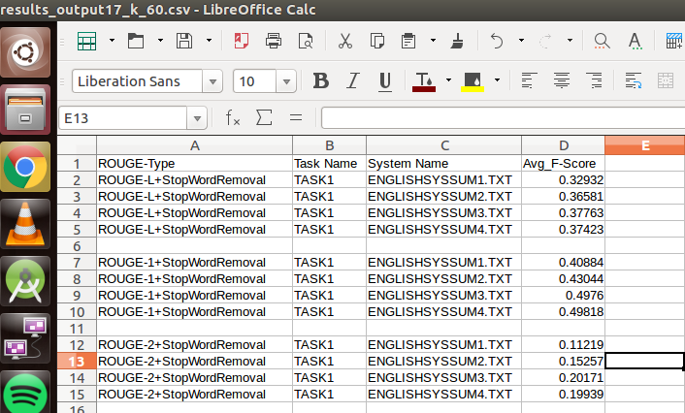
Experimental Results: DUC2002 dataset
Figure: Summary quality measured on DUC2004 dataset with help of ROUGE metric
Summary_1 : BERT + K-means
Summary_2 : BERT + K-means + Centroid-Based-Clustering
Summary_3 : BERT + K-means + Centroid-Based-Clustering +MMR
Summary_4 : BERT + K-means + Centroid-Based-Clustering +MMR+ Sentence Ordering

Slide 13
Determining Number of clusters in K-means clustering model:

Slide 14
Comparison of our Rouge results with existing models :
System | ROUGE-1 | ROUGE-2 | ROUGE-L
LSA | 37. 92 | 7.74 | 35.02
LDA | 35.69 | 6.26 | 32.71
Random | 32.028 | 5.432 | 29.127
Lead | 31.446 | 6.151 | 26.575
DSDR-non | 39.562 | 7.440 | 35.345
Single layer | 37.75 | 8.82 | -
C SKIP | 38.81 | 9.97 | -
PG-MMR | 40.55 | 12.36 | -
Hi-MAP[3] | 43.47 | 14.03 | -
Our model | 48.9 | 18.7 | 37.25

Slide 15
Comparison of our Rouge results with existing models :
Model | ROUGE-1 Score
DUC-best | 0.4986
BSTM | 0.48812
FGB | 0.48507
LexPR | 0.47963
Multilayer | 0.4215
Our model | 0.4893

Slide 16
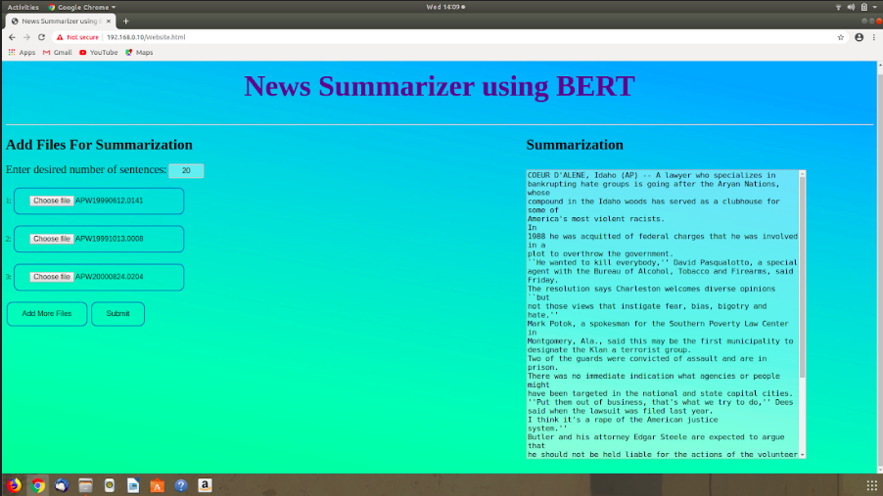
In the end for easy access for user, we designed a web page as a User Interface.
Figure: User Interface design for user end

Slide 17
Conclusion:
In this work, we have implemented BERT text embeddings along with K-means clustering ,centroid-based model using BERT embeddings, MMR, and sentence ordering to produce an extractive multi article news summariser system.
Rouge results implemented on DUC2002 dataset implies that our proposed model is giving good results .
Thus we can say that using BERT for text embeddings improves the quality of the summary for multi-document summarization problem to a good extent.

Slide 18
References:
[1]: https://mccormickml.com/2019/05/14/BERT-word-embeddings-tutorial/
[2]: Gaetano Rossiello, Pierpaolo Basile, Giovanni Semeraro. Centroid-based Text Summarization through Compositionality of Word Embeddings, April 2017.
[3]: Multi-News: a Large-Scale Multi-Document Summarization Dataset and Abstractive Hierarchical Model Alexander R. Fabbri Tianwei She, Department of Computer Science
Yale University

Slide 19
Thank You

